Slide 1
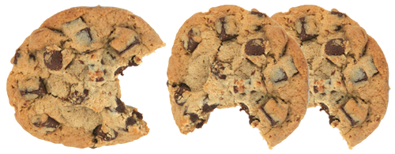
Cookie Monsters
Carrie Clark – Chief Cookie .
Smruti Patil – Cookie Developer
(Team Leader)

Slide 2
The Project – Reality U Program
We were assigned a service learning project for a real customer
Communities In Schools runs a program called “Reality U”
Students fill out a survey of how they will live as future adults, answering questions about education, career, family & spending
Survey results are processed, giving students a scenario to represent their adult life based on their survey choices
Students attend a Reality U event where they learn about the consequences of their choices
Processing of surveys was an onerous manual task.
Our goal: automate this process via a web application

Slide 3
Project Planning
We inherited the project from previous teams
Stand Alone Java application – virtually complete (working)
We focused on creating the Web Application
Code Review
We conducted a code review on the existing application we inherited by:
Reading the application’s documentation and help files
Running the program to see how it works, where it fails, and where it needs improvement
Locating areas that need revisions, additions or have errors, and examining this code and any comments left by the previous team
Using the debugger to step through sections of code that need to be worked on

Slide 4
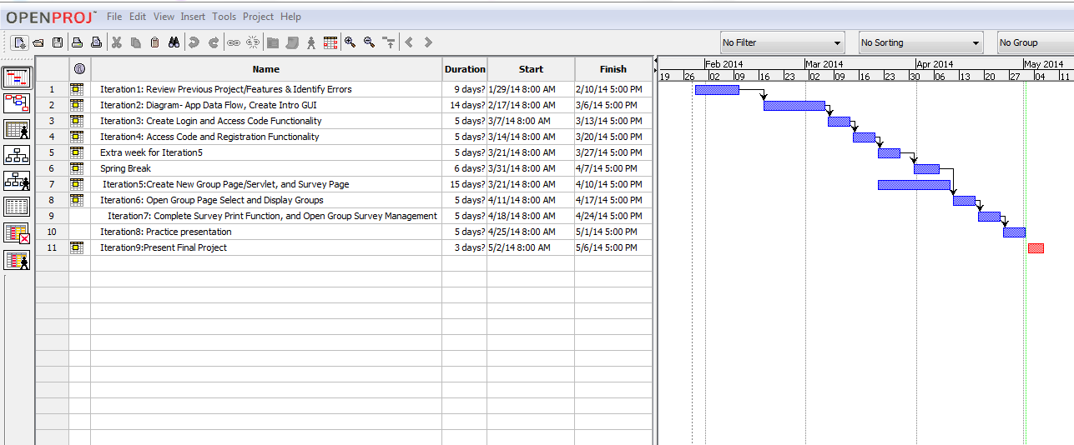
Project Plan - Iterations

Slide 5
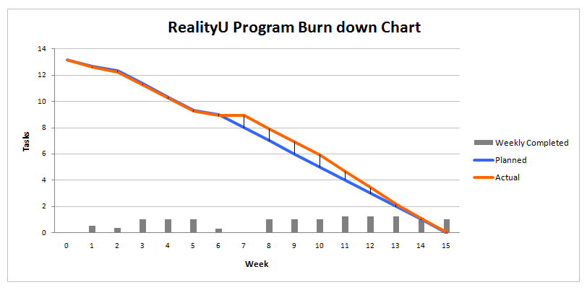
Project Plan – Burndown Chart

Slide 6
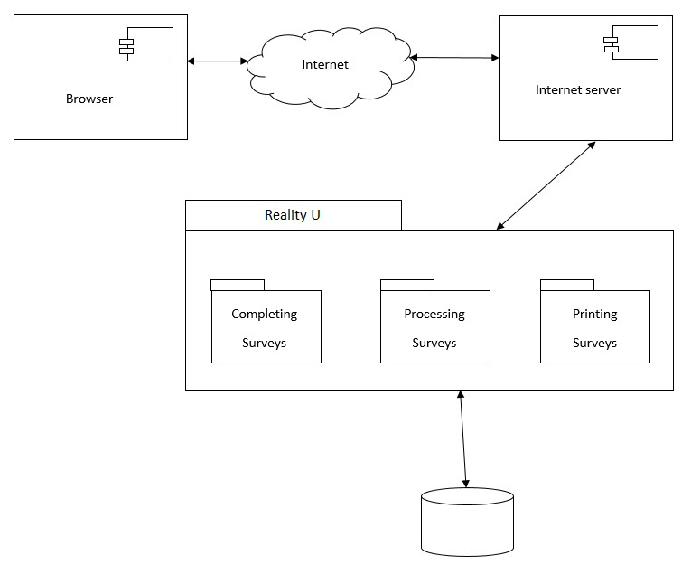
Architectural Diagram

Slide 7
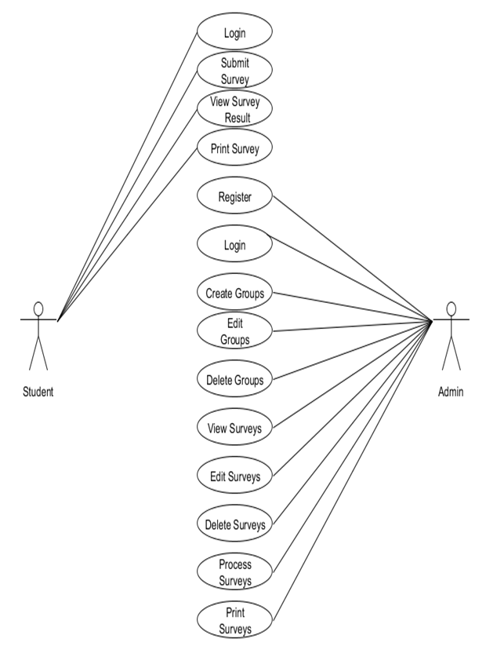
Use Case Diagram

Slide 8
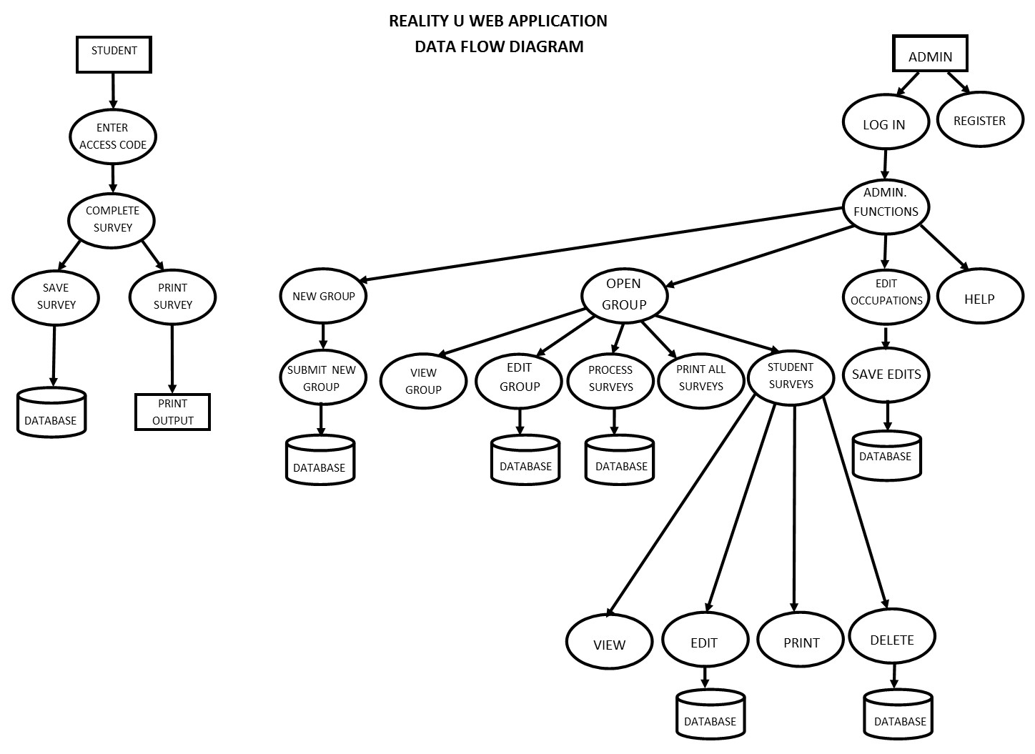
Data Flow Diagram

Slide 9
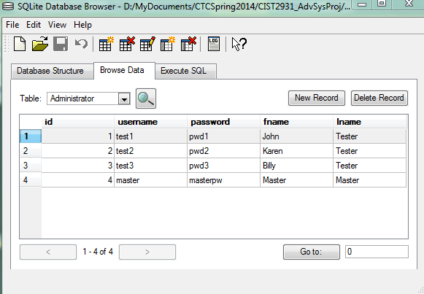
Development Tools & Database
Languages:
Java (JDK 7)
Eclipse IDE
JSP & HTML & CSS
JavaScript
SQL
Server:
Tomcat 7
Database:
SQLite Database Browser (continued using from previous team)
Restructured database design for web application

Slide 10
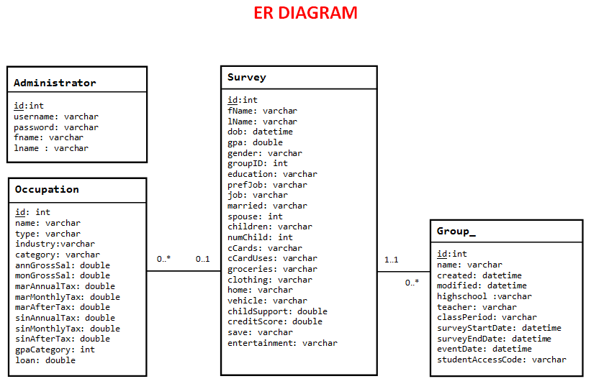
ER Diagram

Slide 11
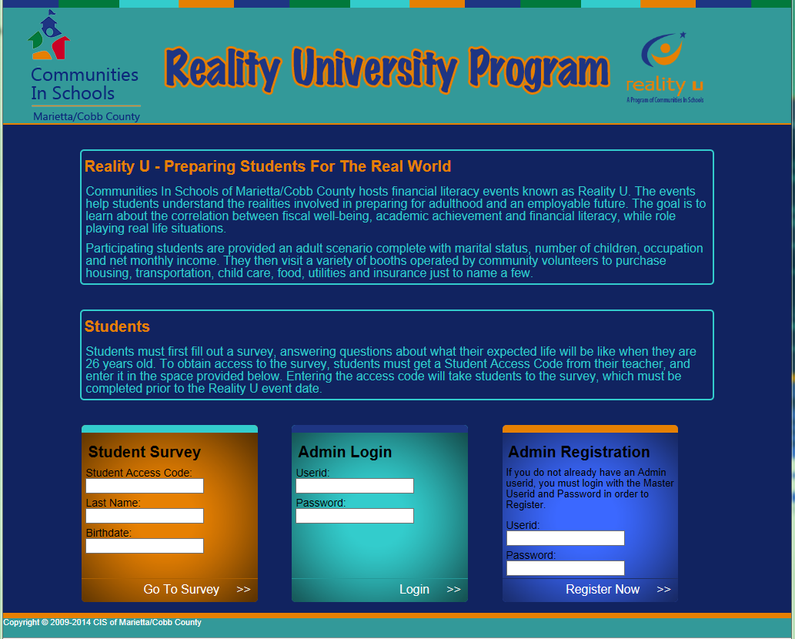
User Interface Design & Development

Slide 12
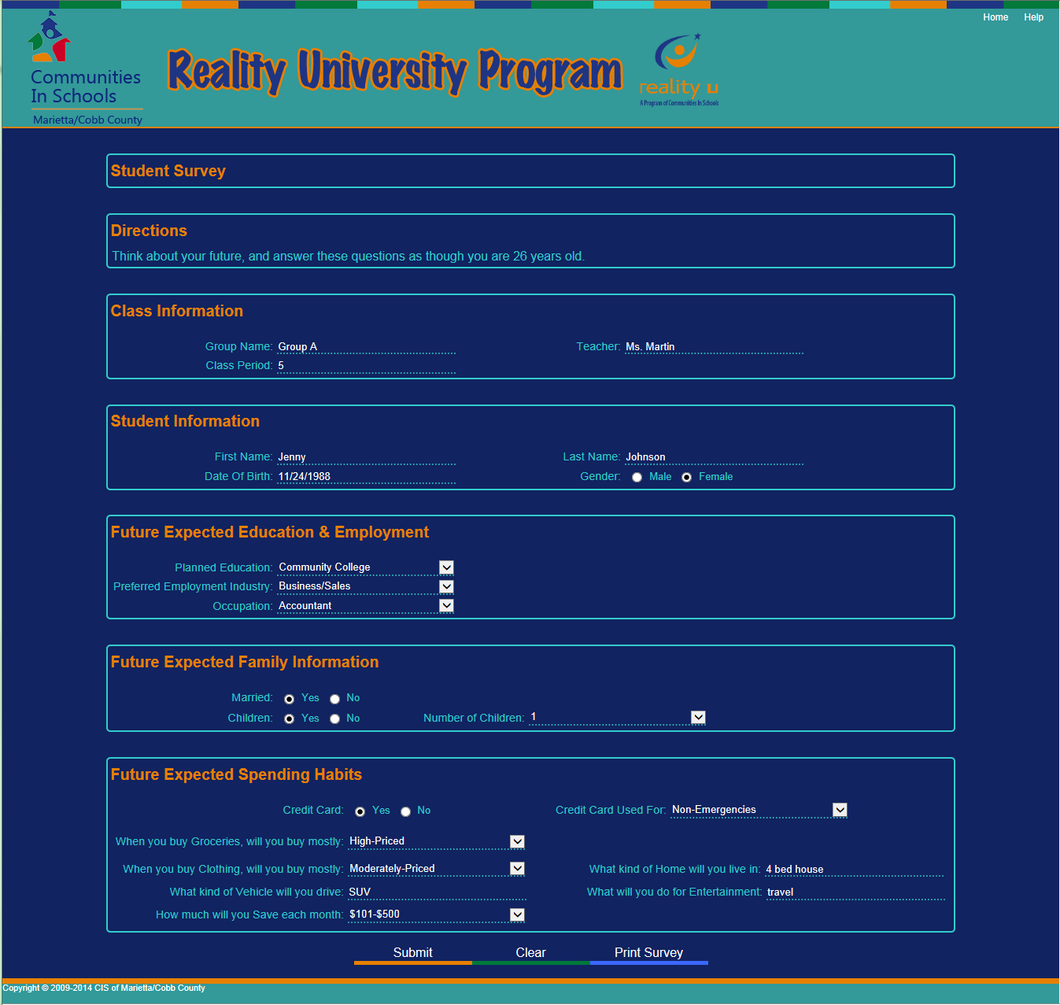
User Interface Design & Development

Slide 13
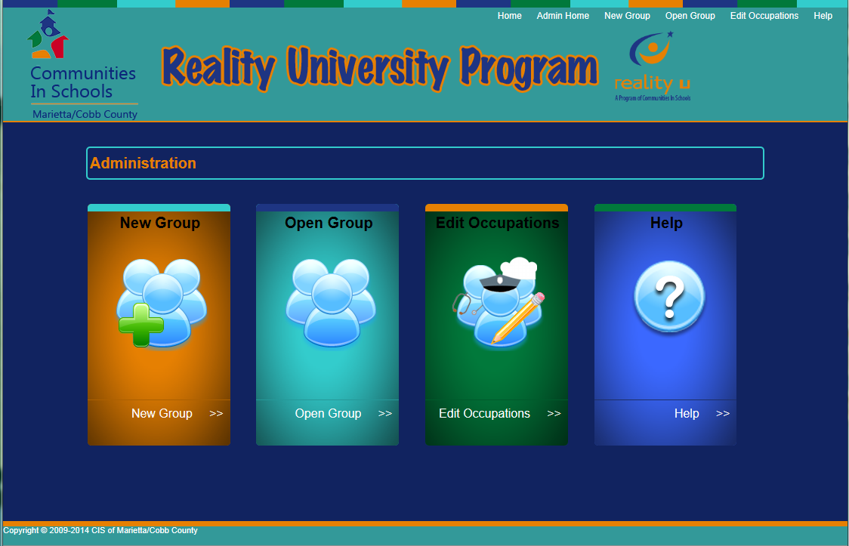
User Interface Design & Development

Slide 14
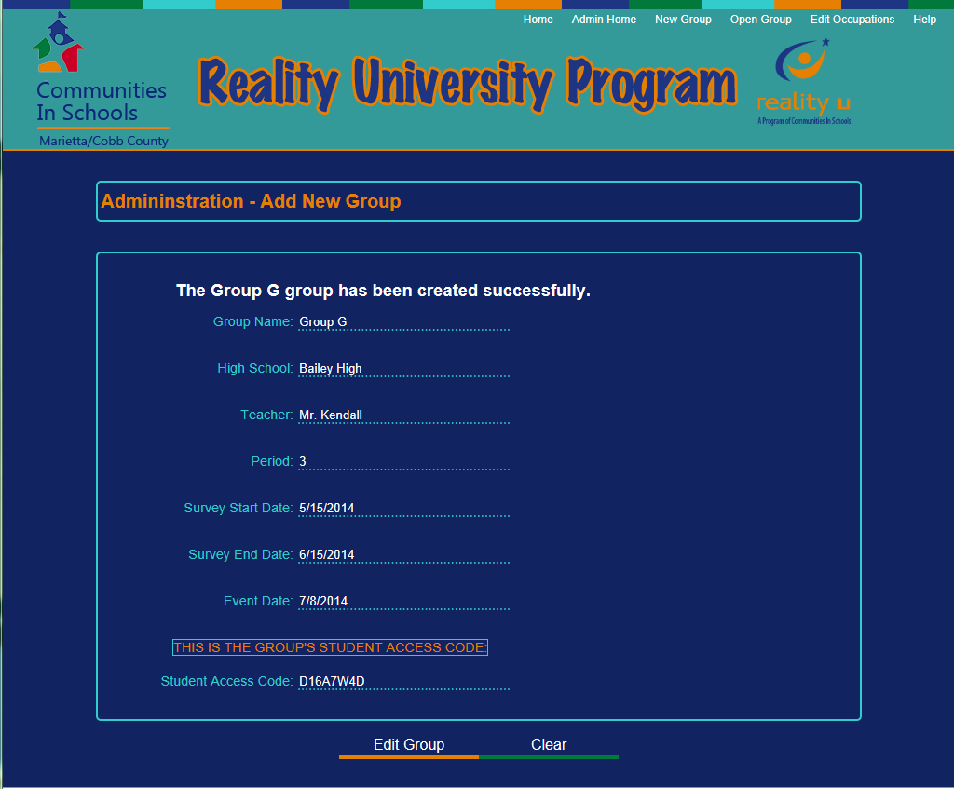
User Interface Design & Development

Slide 15
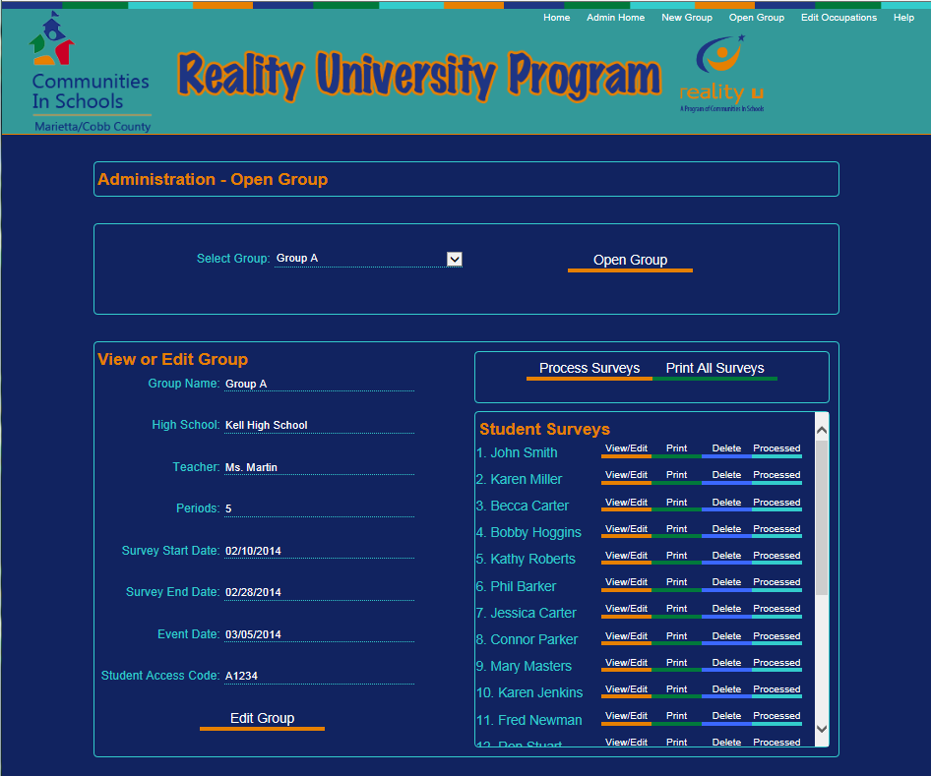
User Interface Design & Development

Slide 16
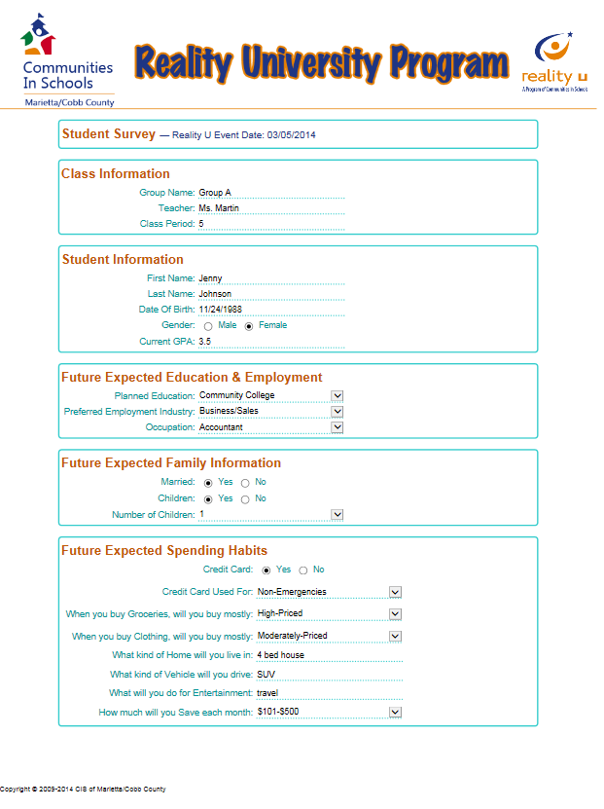
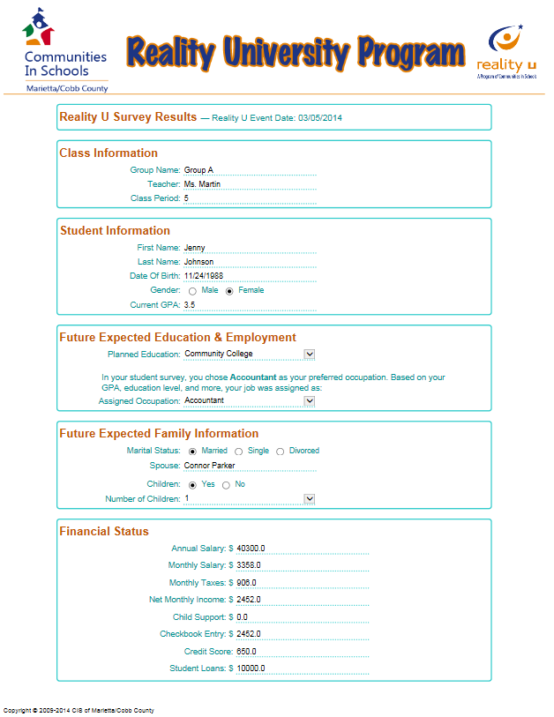
User Interface Design & Development
Student Survey – Print Preview
Processed Survey – Print Preview

Slide 17
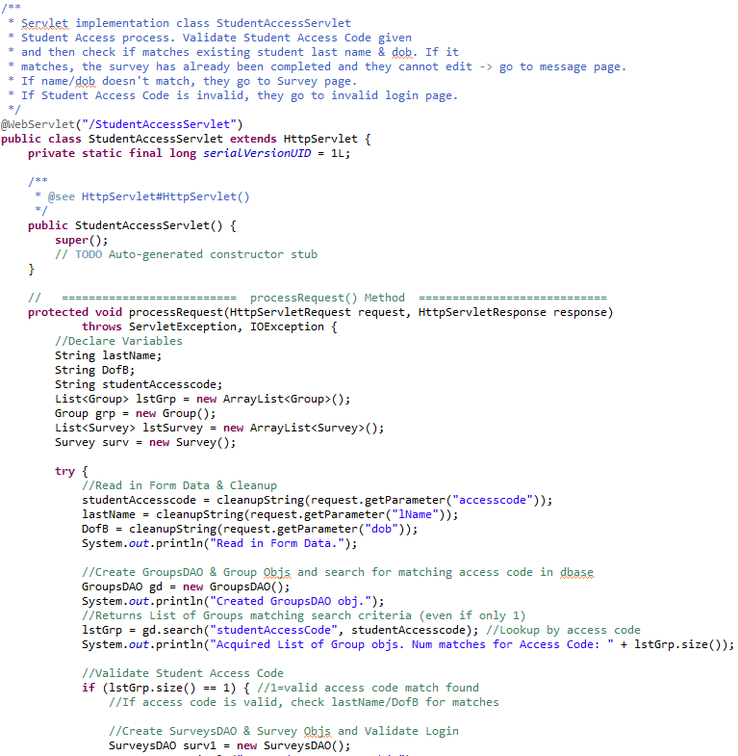
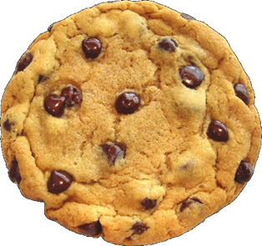
Program Design & Development
Developed/Updated Program Systems
Designed GUI
Redesigned Database
Created Admin Login & Student Access Code
Developed Registration Process
Generated Survey Form & Functions
Created Group & Survey Management System
Implemented Print Functionality for Surveys
Developed Occupation Management System
Created Survey Processing Ability for Job Assignment, Marriage/Spouse Assignment, and Credit Scoring
Code Snippet

Slide 18
Program Design & Development
Backup System
Web applications will be stored on a web server via a web hosting service. Most web host services have backup systems in place to backup all data.
Also it is recommended to keep manual backups of your database & all files via duplicate copies
Install Application
Web Applications are most often uploaded as a WAR (Web Archive format) to a web hosting service via FTP (File Transfer Protocol)
Web Applications are not typically installed on local computers, but we created a JAR file to launch the program in the local browser. Manual server start is required, so some technical savvy is required to run the program this way.

Slide 19
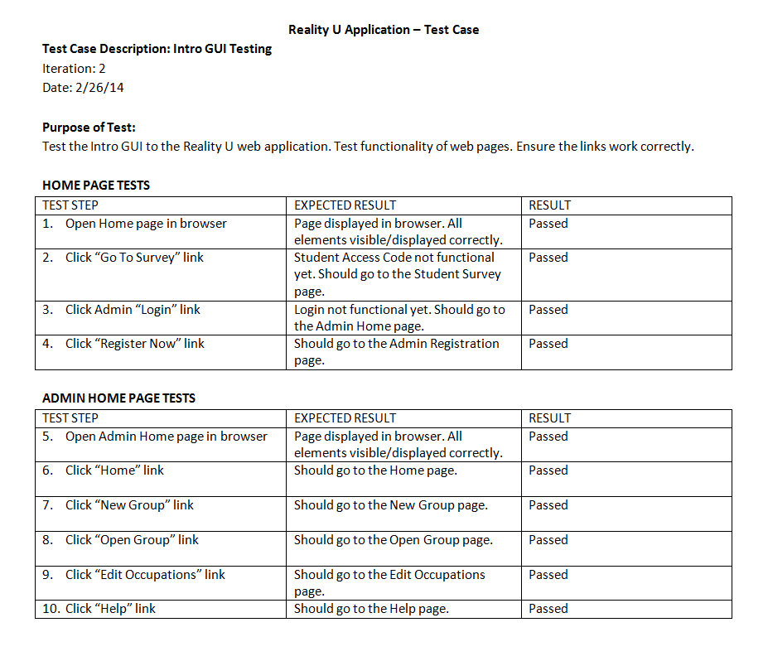
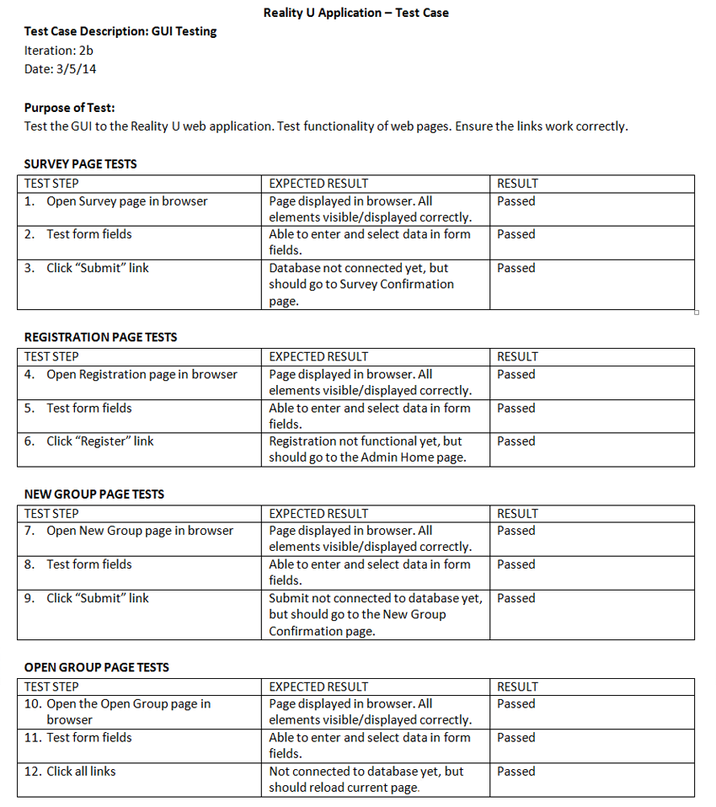
Testing - Manual Script

Slide 20
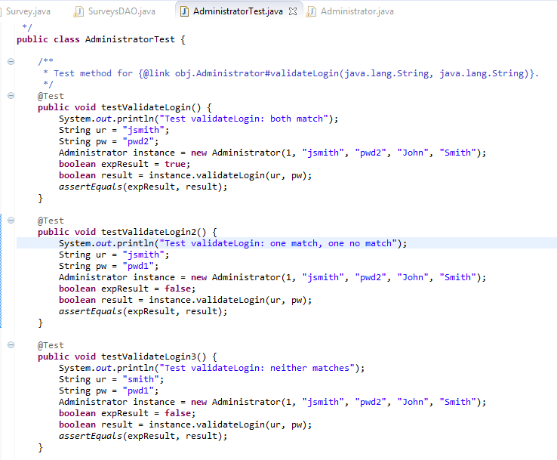
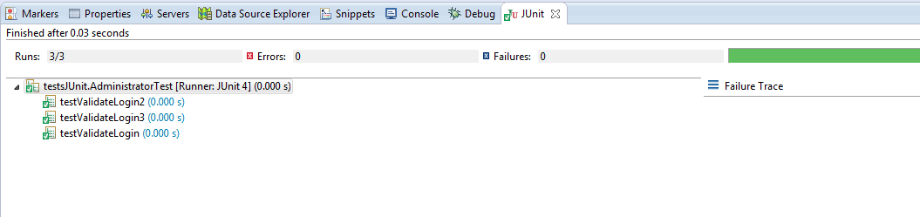
Testing - JUnit

Slide 21
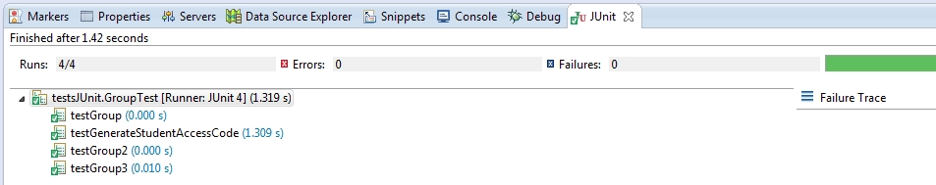
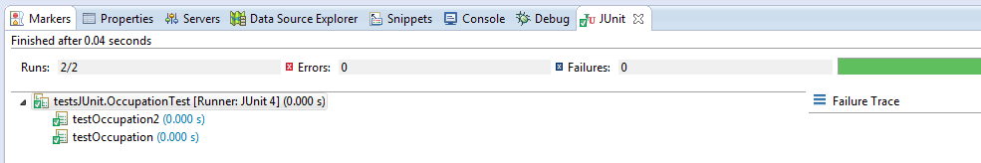
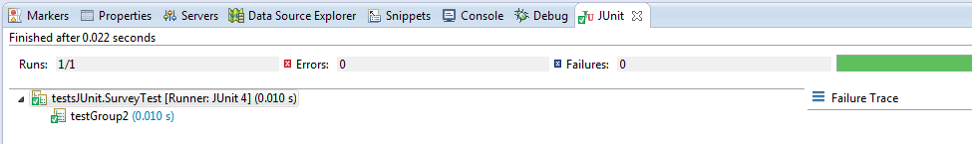
Testing - JUnit

Slide 22
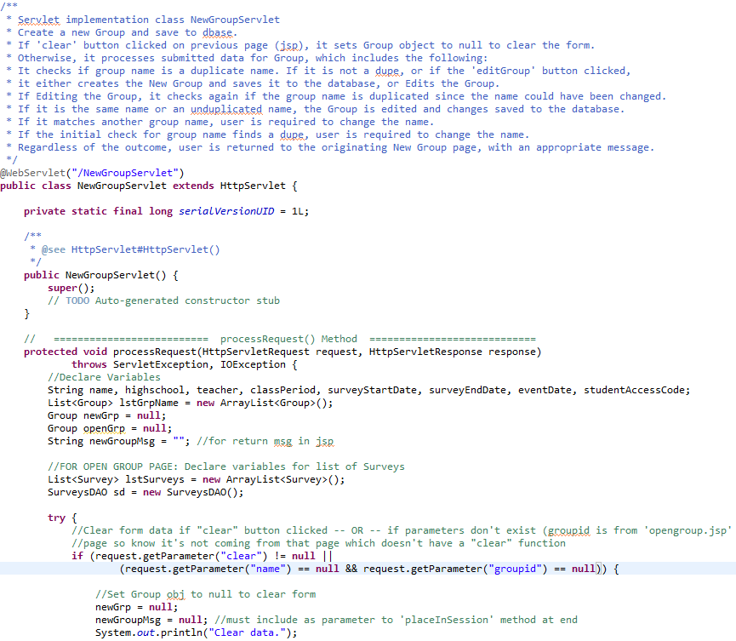
Documentation – Code Comments

Slide 23
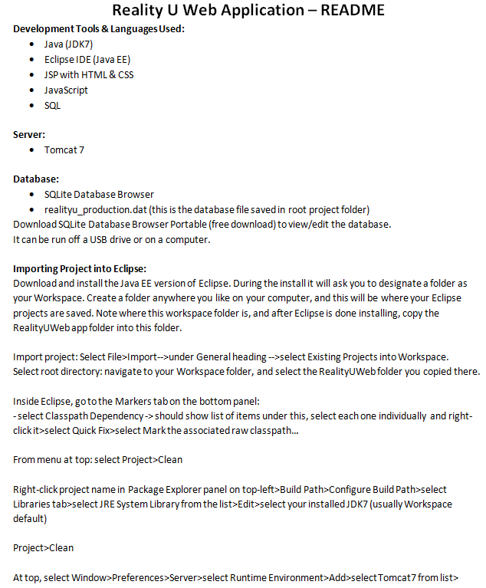
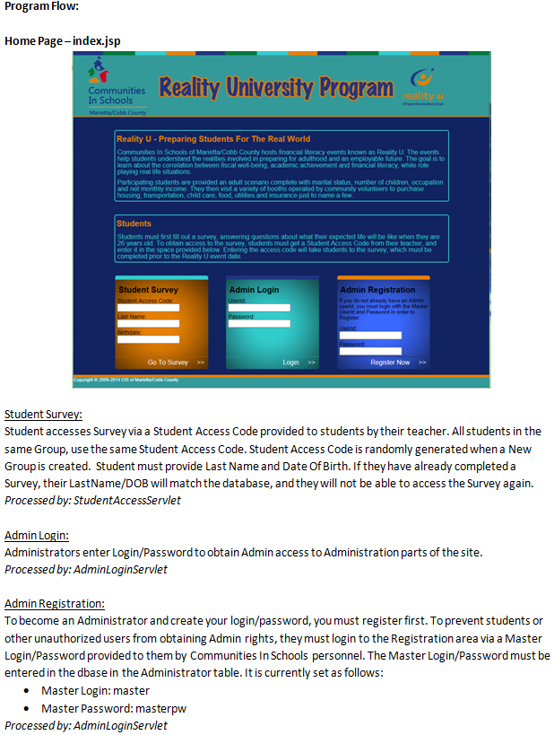
Documentation – README File

Slide 24
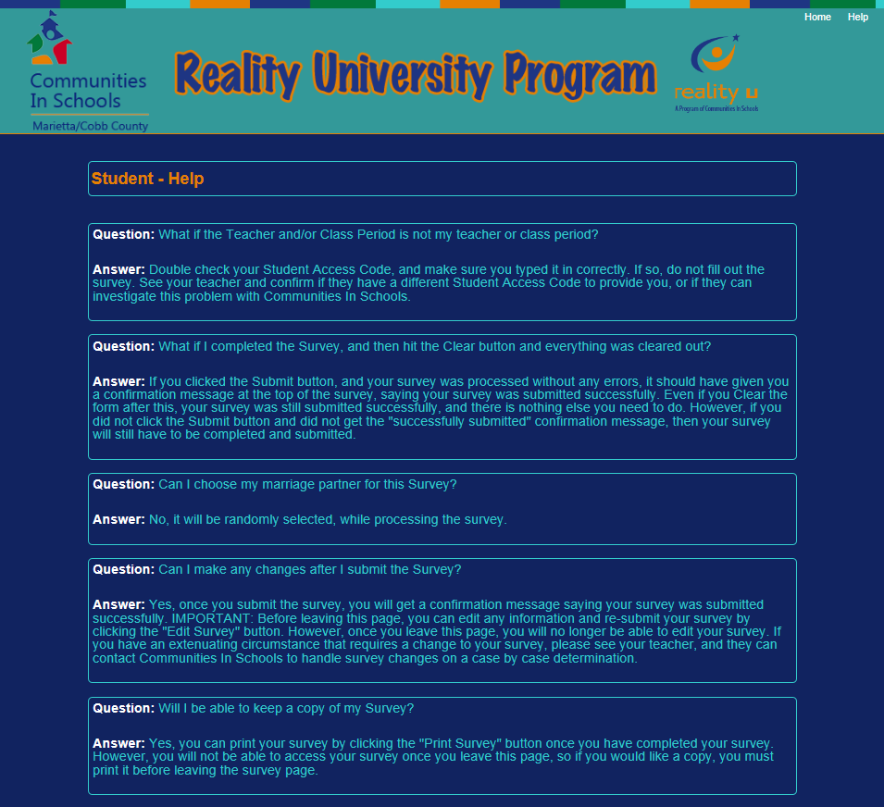
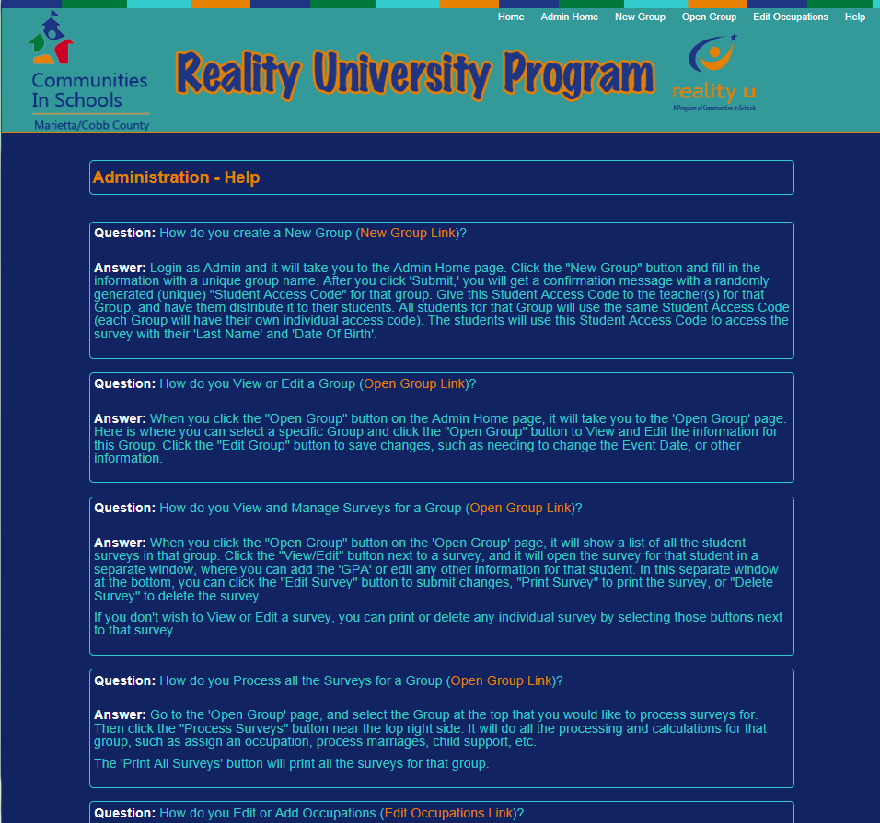
Documentation – Help Facility in App
Student Help
Admin Help

Slide 25

C is for … Code
CODE

Slide 26

Team Philosophy

